Slide 1
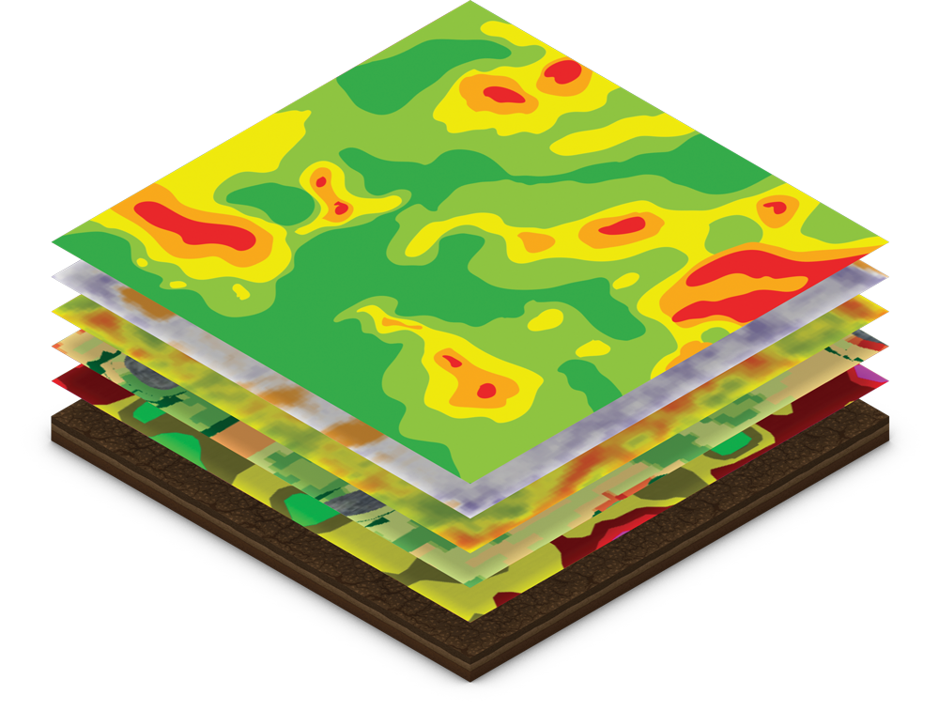





WILDCAT SQUAD
2024 TAPS Hackathon
Kansas State University
Luiz Felipe Almeida - Agronomy
Gustavo Santiago - Agronomy
Gabriel Hintz - Agronomy
Carlos Hernandez - Agronomy

Slide 2

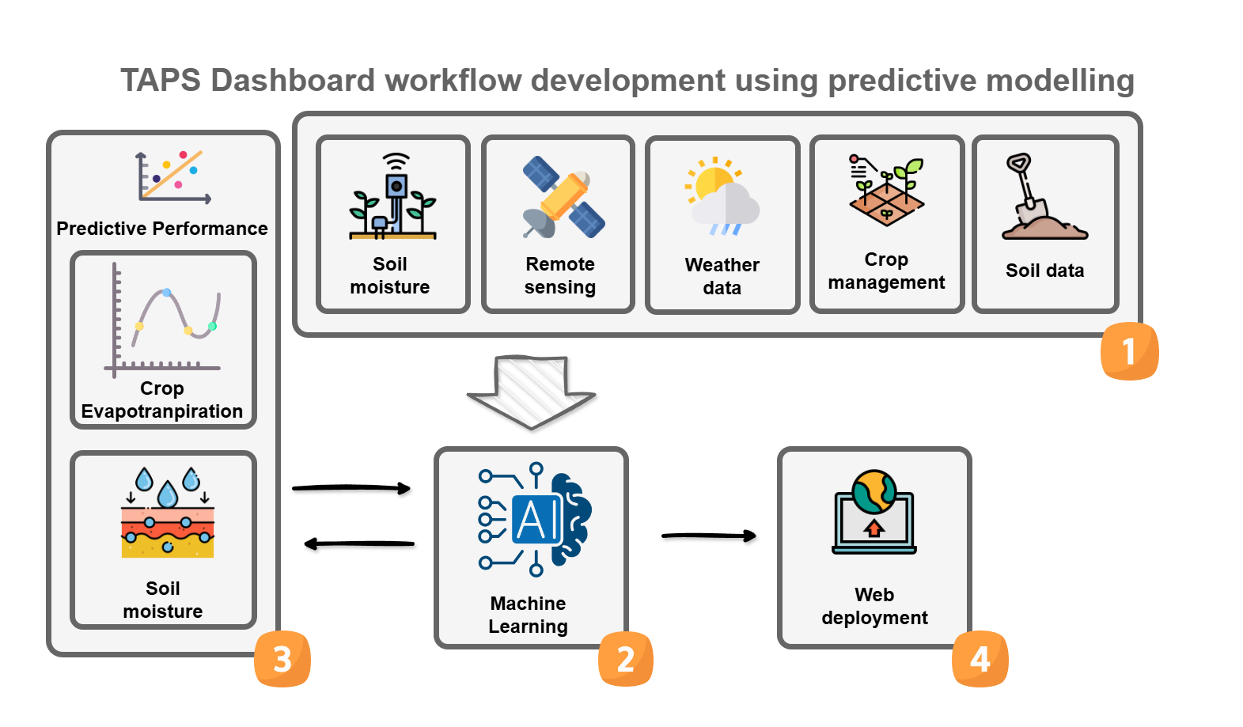
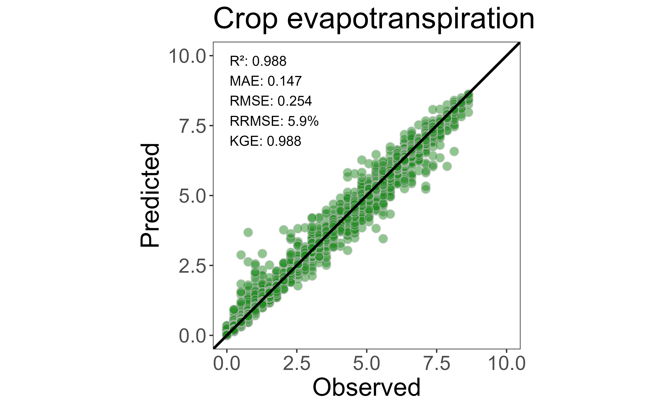

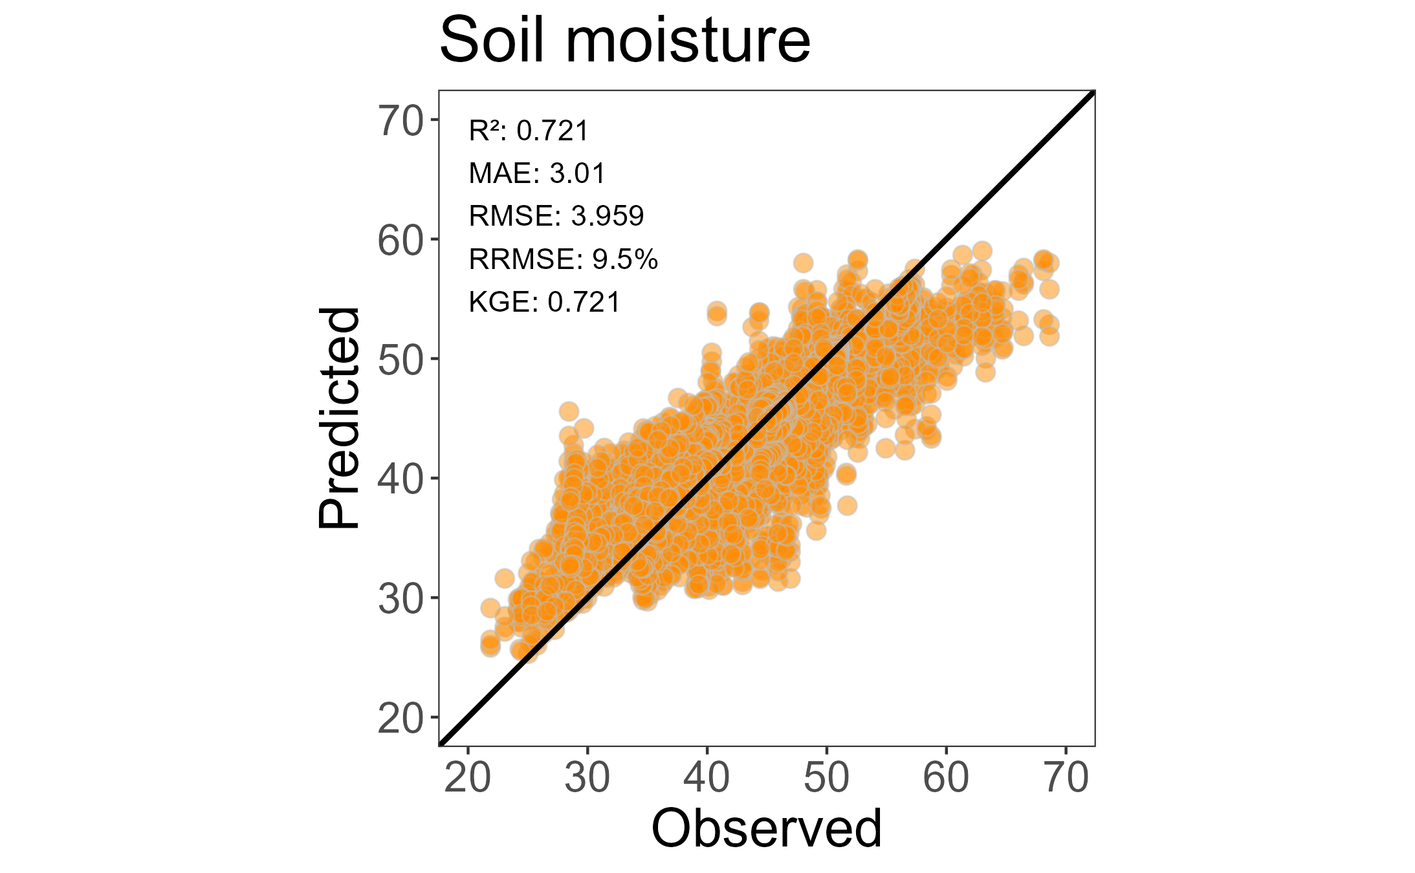

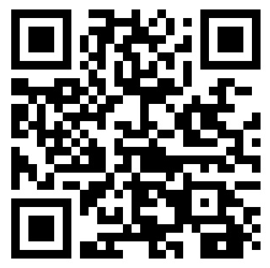
ACCESS
THE
DASHBOARD
What’s next?

